Slide 1
ITSC 306: Computer Forensics
Module 3: Live Response

Slide 2
Module Readings
Incident Response & Computer Forensics: Third Edition
Chapter 7: Live Data Collection
Command-line reference A-Z (https://technet. microsoft.com/en-ca/library/bb490890.aspx)

Slide 3
Incident Response Defined
Incident Response is a set of procedures for an investigator to examine a computer security incident. This process involves figuring out what has happened and preserving information related to those events. Because of the fluid nature of computer investigations, incident response is more of an art than a science.
(Incident Response, n.d.)
Notes:
No two examinations are the same.
There are parts of the investigation which are consistent with other investigations but based on the results different follow-up investigation is required.

Slide 4
What is Incident Response?
Incident response is a coordinated and structured approach to go from incident detection to resolution. Incident response may include activities that:
Confirm whether or not an incident occurred
Provide rapid detection and containment
Prevent a disjointed, noncohesive response
Determine and promote facts and actual information
Minimize disruption to business and network operations
(Luttgens, Pepe and Mandia, 2014)

Slide 5
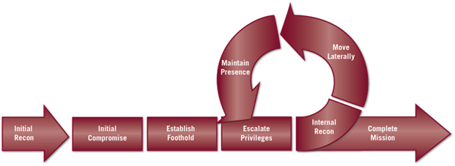
Exploitation Life Cycle
Reconnaissance
Initial Intrusion into the Network
Establish a Backdoor into the Network
Obtain User Credentials
Install Various Utilities
Privilege Escalation/Lateral Movement/Data Exfiltration
Maintain Persistence
(Source: Luttgens, Pepe and Mandia, 2014)
Notes:
This is the typical work flow for a state sponsored hacker.
One of the reasons for obtaining user credentials is that this allows the attacker to move around the network looking like an authorized user
The goal is to get into the network without being seen and then using different persistence mechanisms to stay in the network even if discovered.
It is not uncommon for the attacker to establish a foothold on 50 or more computers in a large network to maintain persistence.
The attacker may install his utilities or use utilities already on the network like the PSToolset from Microsoft.
There are cases of the attacker putting sleeperware on a system which once a year will ping out to the attacker letting him back into the network if he has been shut out of it.

Slide 6
Incident Response
The potential loss of valuable information if we shut the system down prior to gathering the volatile information overrides the concern of altering data on the system
Requirement: Document everything you do prior to pulling the plug
There are several ways to gather the information:
Open source or commercial tools
Build your own live response toolkit using open source/free software and scripting the use of the tools
Notes:
The reason for taking detailed notes is that you may have to establish why you interacted with the live system and what actions you took.
You also need to be aware of any changes to the system created by running a live response and be able to explain them in court if questioned.

Slide 7
IR – Forensic Process
Data Collection
Data Processing
Minimize
Host-Based Data
Live Data
Forensic Duplications
Information
Information
Network-Based Data
Review
Review
Relevant
Information
Other Data
© 2017, Southern Alberta Institute of Technology
Leads
Notes:
The investigation starts with a collection of large amounts of data which then have to be processed to minimize the amount of data to just what is significant to the event being examined.
Other data can be things such as interviewing the user that discovered the incident, System Admin interviews, Closed Circuit TV to see who was in the building or in the data centre, etc.

Slide 8
Incident Response Process
Prepare: The incident response process starts with preparation. You don’t want to figure it out while dealing with an incident which includes creating your Computer Incident Response Team (CIRT).
Identify: Is this a real incident?
Contain: Limit the impact of the incident by controlling the scope and magnitude
Eradicate: Eliminate or mitigate the threat
Recover: Return to the pre-incident state
Lessons Learned: Determine what did and didn’t work during the incident. Keep what did work and fix what didn’t. This becomes part of the preparation for the next incident.
Prepare
Identify
Contain
Eradicate
Recover
Lessons Learned
Notes:
Preparation includes things such as forming your CIRT, knowing your network, having up to date network diagrams, having a communications plan, having all of the equipment available which you might need, implement robust logging in your environment, etc.
Identify if this is a real incident based on the information available. Need to determine the nature and possible impact of the incident. This is usually done by the CIRT leader who will escalate to a full incident if required.
Containment is trying to limit the impact of the incident by controlling its scope and magnitude. Can include things such as changing passwords, blocking attacking IPs, virus removal
Eradication is the elimination or mitigation of the vulnerability which caused the incident to occur
Recovery is brining the network or impacted systems back to operations / production status. This could be to a known good backup or rebuilding the systems. Once recovery has been completed there is a need to monitor and validate that the attack has been contained.
Lessons Learned is brining everyone involved in the incident into a room and discussing what worked and what didn’t work. We keep what did work and find a way to fix the things that didn’t work. This then becomes part of the preparation phase for the next incident.

Slide 9
CIRT Team Membership
Includes identification of core incident responders (typically corporate security) as well as ancillary members from supporting organizations. Participants may include:
Network Operations
Desktop/Server Support
Application Representatives
Internal and External Legal Counsel
Compliance Officers
Privacy
Business Line Managers
Human Resources
Public Relations
Executive Management
Other SMEs as required
Third Party Specialists
Notes:
9
Public Relations or the Communications Department are important members of the team and need to be included from the onset of the CIRT.
This is because they need to be aware of the situation and be able to answer questions from the media when the breach become public knowledge which it will.
Legal counsel is important and the CIRT should consider reporting through the Legal Dept. as this then makes the report work product and makes it subject to solicitor / client privilege which will make it more difficult for external parties to obtain copies of the report.
Executive management needs to be kept informed of the status of the incident. This also brings forth a common saying “Never waste an incident” as this is a good opportunity to seek funding for security projects you may want to bring forward as the executive are now aware of the problems and costs (Both Financial and Social) associated to responding to an incident.

Slide 10
Initial Incident Response by Investigators
Understand how cyber attacks occur
How Windows and Unix systems are attacked
Understand how to collect the data/evidence
Live data collection
Forensic duplication
Network surveillance
Interviews
Understand how to interpret the data/evidence
Host-based evidence
Network-based evidence
Other evidence
Cyber Attack
Data Collection
Forensic Analysis
© 2017, Southern Alberta Institute of Technology

Slide 11
Live Response
In Computer Forensics, we usually look at files on a system after we have imaged the device using a write block device
There are instances when we have to look at files on a system before making the image, such as:
During the Incident Response (IR) of a network breach
Triaging a system during a criminal investigation
Notes:
During an active incident we need to collect the volatile data before pulling the plug on the system and making an image of the hard drive.
In a child pornography investigation there may be a need to triage multiple systems to determine if they may hold the illicit images.

Slide 12
When to Perform a Live Response
Is there reason to believe that the volatile data contains information that is vital to the investigation that is not available elsewhere?
Are there a large number of systems to be analyzed, making forensic duplication impractical?
Are there legal considerations making a full forensic duplication unwise?
Will making forensic duplications take an excessive amount of time or possibly fail?
(Luttgens, Pepe and Mandia, 2014)

Slide 13
Possible Issues with a Live Response
Have you tested the live response tool on a similar platform?
Is the system particularly sensitive to performance issues?
If the system crashes, what is the impact?
Have you communicated with all of the stakeholders and received their approval?
Consider getting it in writing
(Luttgens, Pepe and Mandia, 2014)
Notes:
You should test your live response toolkit before using it. Know how it behaves and is it likely to bring a system down and will it collect all of the items you are after.
If creating your own LRK you should have a different LRK for each type of operating system and operating system version you may need to examine.

Slide 14
Collection Best Practices
Document what you do and when you do it
Get on and off the system quickly
Use tools that minimize impact on the target system
Fully automate the process
Collect in order of volatility
Treat collected data as evidence
Consider any credentials you use as lost to the attacker
Minimize modifications to suspect computer
(Luttgens, Pepe and Mandia, 2014)
Notes:
There is always the possibility that the attacker may be monitoring activity on the compromised system including capturing passwords.
As a result you should always change the password on the account used to investigate the incident once you have completed your investigation.

Slide 15
Collecting Volatile Data
RFC 3227 contains the Guidelines for Evidence Collection and Archiving which is used as the basis of our Live Response process
Among the contents of this document is the Order of Volatility (or OOV) which specifies the order in which it is suggested you collect data based on the volatility of the data

Slide 16
Breaking from Tradition
There is a common belief that there is not sufficient forensic information contained within the CPU cache and register contents to merit the effort required to acquire the data
The remaining volatile data is invaluable to an investigation
Notes:
There is always the possibility that the attacker may be monitoring activity on the compromised system including capturing passwords.
As a result you should always change the password on the account used to investigate the incident once you have completed your investigation.

Slide 17
Volatile Information
Volatile Information Includes:
Memory
Open TCP/IP Ports
Running Processes
Running Services
Open Files
Processes Opening TCP/IP Ports
Network Interface Information
Routing Table

Slide 18
Building a Live Response Toolkit
Typically run from a DVD or USB Drive
Should be scripted and run from a single command
“Known Good” copies of any commands from the basic operating system should be copied to the toolkit as well as a “Known Good” copy of the cmd.exe file.
Remember to add any required DLLs or other system files for the commands you will be running.
Notes:
The advantage to running from a DVD is that the contents can’t be changed and the DVD could be entered into court and it would show which commands had been run.
The advantage of the USB drive is that you can have the results of the live response kit saved to the USB drive the tools are run from.
You could also use the same USB drive on multiple systems if large enough.
This way you have all of the results in one location.

Slide 19
CMD.EXE Internal Commands
Some commands are internal to the cmd.exe command shell, such as date and time.
When running the date and time commands during your live response add the /t switch, which causes the command not to ask for date or time input.
This makes the command non-interactive and will not require any input to move onto the next command in the LRK script.
Notes:
Some commands are internal to the command shell.
The reason we use a known good copy of the cmd.exe is that it is possible to rename the internal commands.
This means that when running the dir command it may actually be the delete command being run.

Slide 20
System Date and Time
Once we have the system’s date and time information, we need to:
Determine the system’s offset from actual date and time
Show date/time offset when comparing system information when multiple systems are involved in the investigation
Show in investigative documentation what date/time the live response started and finished

Slide 21
Windows Tools To Consider Including
Microsoft Utilities
date
netstat
tlist / tasklist
nbtstat
at / schtasks
ipconfig
arp
regdump
LogParser
UserDump
Windows Sysinternals
psservice
psfile
psinfo
Windows Sysinternals…
psloggedon / logonsessions
autoruns
psloglist
handles
Other Apps
cports / openports
Extra Utilities
dd
UnxUtils zip
md5sum
nc (netcat)
Notes:
There may be other tools you decide you want to run depending on the operating system or version.

Slide 22
Standard Live Response Summary
Load Live Response Kit (LRK) on victim
May be an external USB hard drive or a DVD
Open Trusted Command Shell from the LRK
Run as Administrator
Address external storage path
Do this within the response script
Run the response script
Notes:
Do not copy the Live Response Kit onto the victim system hard drive.

Slide 23
Scripting the Live Response
Automation is necessary
Eliminate errors due to typing
Consistent data from multiple systems
Work smarter, not harder
Use batch scripting
Your scripts can be as simple or complex as you have the time to invest in their creation
IMPORTANT: Test your scripts before you need them

Slide 24
Scripting Your Toolkit
@echo off
hostname > tmphost
set /p hostvar= < tmphost
del tmphost
t_dumpit /T RAW /Q /N /O Results/%hostvar%.mem
echo ******************************************
echo Windows 7 Live Response
echo ******************************************
echo ******************************************** >> Results/%hostvar%.txt
date /t >> Results/%hostvar%.txt
time /t >> Results/%hostvar%.txt
Notes:
The beginning of your script may look like this which will save the results of each action to a folder named Results/[systemhostname].txt
The first section creates the hostname variable and captures the system memory using dumpit.
The next section will show what you are running on the system screen in this case a “Windows 7 Live Response” and then creates a text file and appends the results of each command to the text file starting with the current system date and time and then ending with the date and time. It then creates an MD5 hash for the memory dump and text file with the results of the LRK.

Slide 25
Storing Live Response Output
Do not write to the victim machine’s hard disks
Responder’s machine
netcat
cryptcat
USB device
Exercise caution
Inserting USB device causes registry and other activity on Windows systems
Might crash the victim machine
NT 4.0 very unstable in regard to USB devices

Slide 26
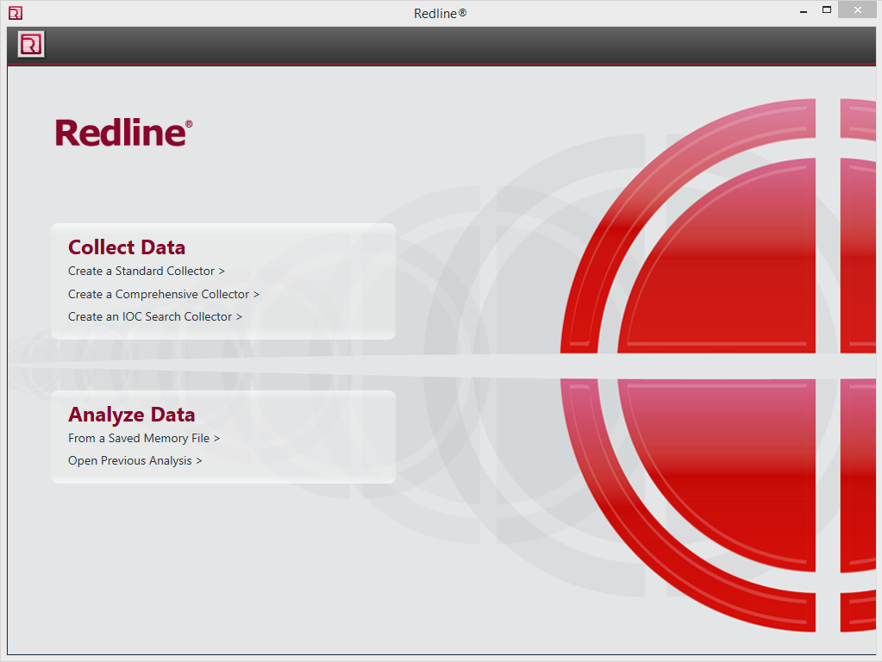
Mandiant’s Redline
The easy way to construct a live response kit
Source: Redline, 2017.
Reproduced and used in accordance with SAIT’s Fair Dealing Policy (Schedule A Copyright and External Materials Procedure AC.2.12.1); further distribution may infringe copyright.
Notes:
Mandiant, a division of Fireeye, has released a Live Response tool called Redline which can be used for internal systems, but not used for external systems such as a conducting Incident Response for another company.
Redline can be used to conduct a live response or review a memory image or live response using Redline.
Redline automates the process of creating a live response kit.
It was important to go through the process of creating your own live response kit because commercial or open source products won’t work on all systems under all circumstances.

Slide 27
Redline
Automates the collection of volatile data
Collects other information as well
Source: Redline, 2017.
Reproduced and used in accordance with SAIT’s Fair Dealing Policy (Schedule A Copyright and External Materials Procedure AC.2.12.1); further distribution may infringe copyright.

Slide 28
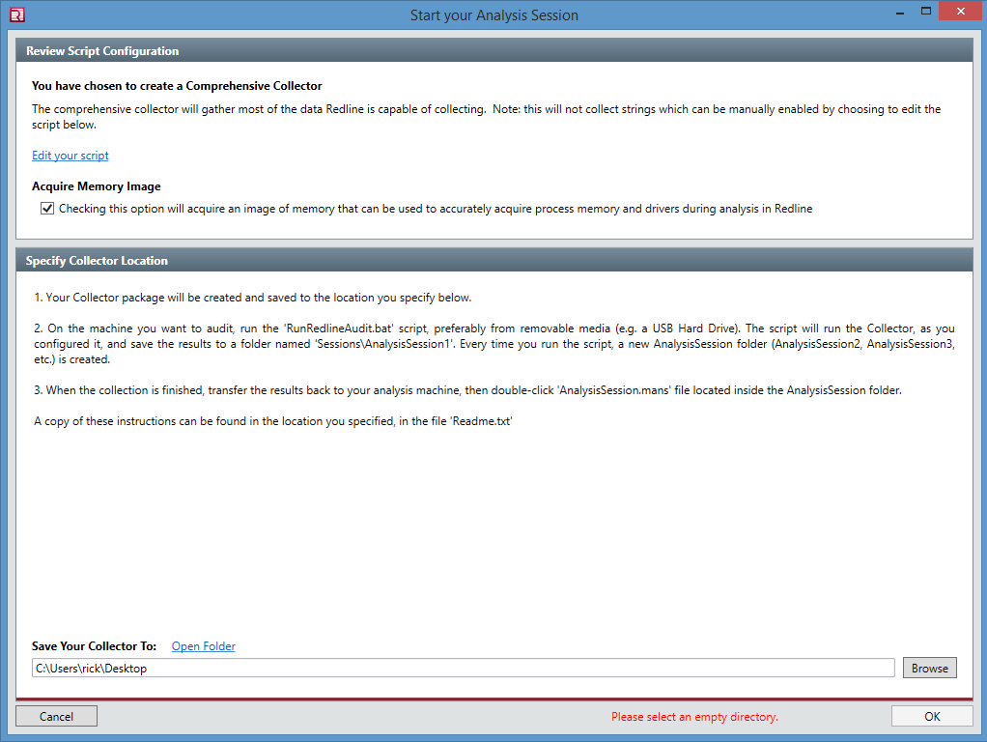
Create a Comprehensive Collector
Edit your script
Browse to where you are going to save the file
Note: Can be used internally but you must contact Mandiant before use for third parties.
Source: Redline, 2017.
Reproduced and used in accordance with SAIT’s Fair Dealing Policy (Schedule A Copyright and External Materials Procedure AC.2.12.1); further distribution may infringe copyright.

Slide 29
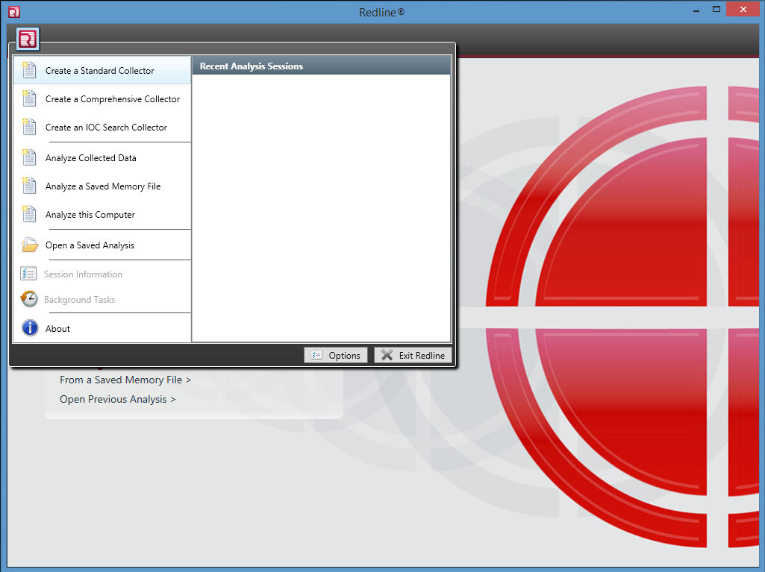
Pick Your Poison
This is the menu that allows you to create a collector or analyze a collection.
Source: Redline, 2017.
Reproduced and used in accordance with SAIT’s Fair Dealing Policy (Schedule A Copyright and External Materials Procedure AC.2.12.1); further distribution may infringe copyright.
Notes:
Options include:
Create a Standard Collector
Create a Comprehensive Collector
Create a IOC Search Collector
Analyze Collected Data
Analyze a Saved Memory File
Analyze this Computer
Open a Saved Analysis

Slide 30
Indicators of Compromise (IOC)
Collected from host- and network-based signatures used to identify malware-related activity
During incident response, malware is detected and then analyzed to develop signatures (e.g., MD5, path, file name and size, strings)
These signatures are then used to create IOC
Systems suspected of being compromised have the signatures run against them to determine if the same or similar malware is on the system.
The signatures can be run using a standalone product, such as Mandiant’s Redline, or an enterprise tool like Mandiant’s MIR.

Slide 31
IOC Resources
IOC Editor (https://www.fireeye.com/services/freeware/ioc-editor.html)

Slide 32
Tasking Trojan
Sample IOC File
Notes:
This shows a sample IOC file which you can download and run against a system to look for the “Tasking Trojan”

Slide 33
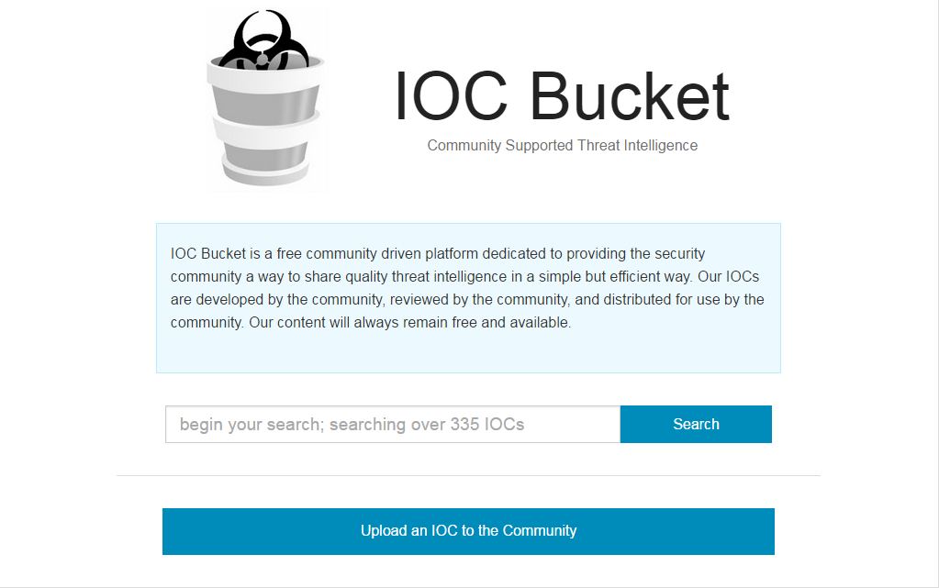
www.iocbucket.com
As of 2017.02.17 there were 368 IOCs on site
Oldest Post
2013.10.25
Most Recent Post
2017.09.27
Source: https://www.iocbucket.com/

Slide 34
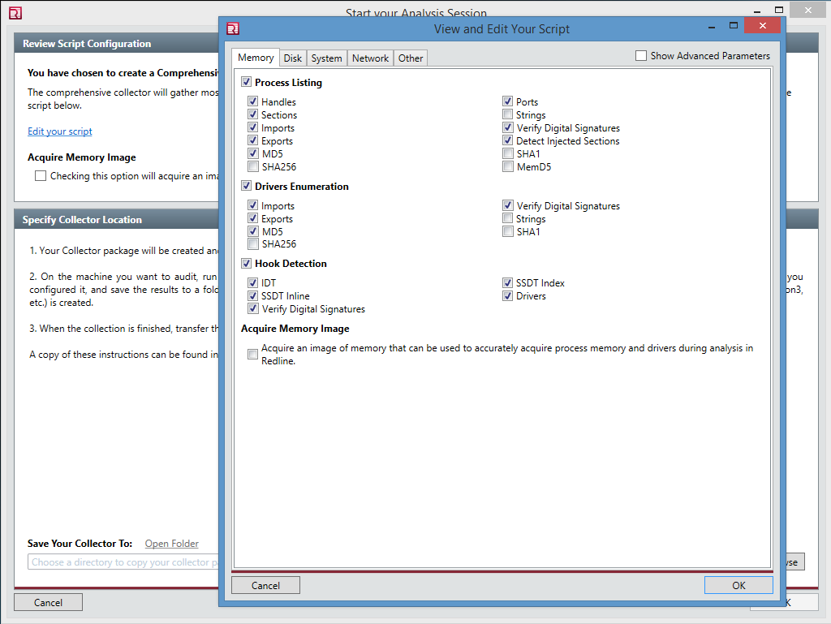
Editing Your Script - Memory
Allows the user to choose which parts of memory to collect
Items such as strings will take longer to collect and greatly increase the size of the collection
Allows user to pick which hashing algorithm they want to use.
Source: Redline, 2017.
Reproduced and used in accordance with SAIT’s Fair Dealing Policy (Schedule A Copyright and External Materials Procedure AC.2.12.1); further distribution may infringe copyright.

Slide 35
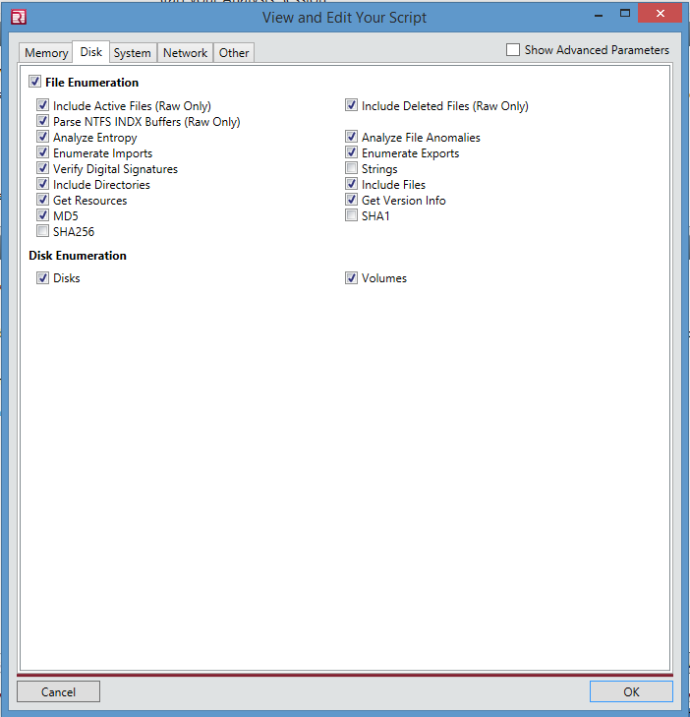
Edit Your Script - Disk
User needs to Consider the size of the collection and the time required to collect it.
Some options require the computer to have an Internet connection.
Source: Redline, 2017.
Reproduced and used in accordance with SAIT’s Fair Dealing Policy (Schedule A Copyright and External Materials Procedure AC.2.12.1); further distribution may infringe copyright.

Slide 36
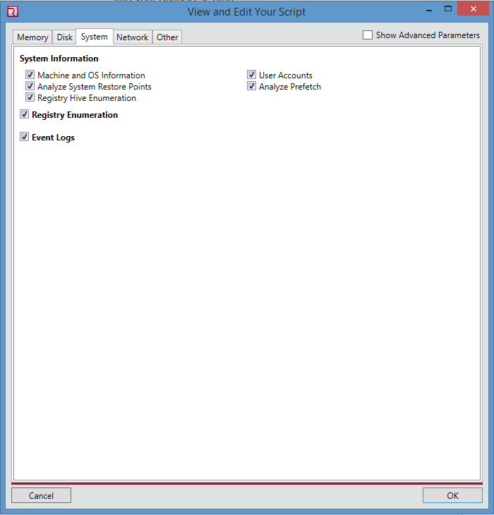
Edit Your Script - System
This section allows for gathering information about the computer and its users.
Also gathers information from the Registry, Restore Points and Event Logs
Analyzes the system’s Prefetch files
Source: Redline, 2017.
Reproduced and used in accordance with SAIT’s Fair Dealing Policy (Schedule A Copyright and External Materials Procedure AC.2.12.1); further distribution may infringe copyright.

Slide 37
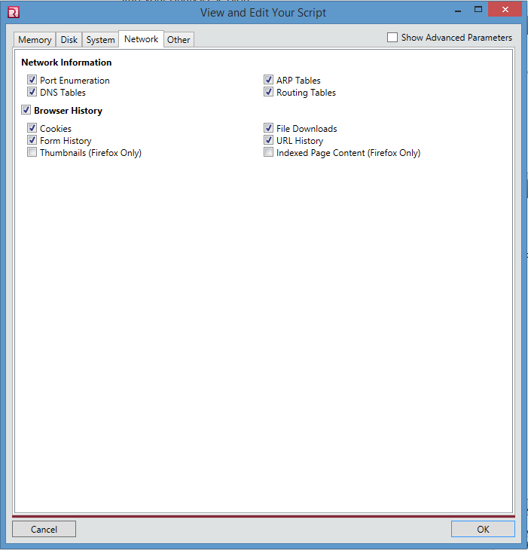
Edit Your Script - Network
Gathers information about network traffic and internet history
Source: Redline, 2017.
Reproduced and used in accordance with SAIT’s Fair Dealing Policy (Schedule A Copyright and External Materials Procedure AC.2.12.1); further distribution may infringe copyright.

Slide 38
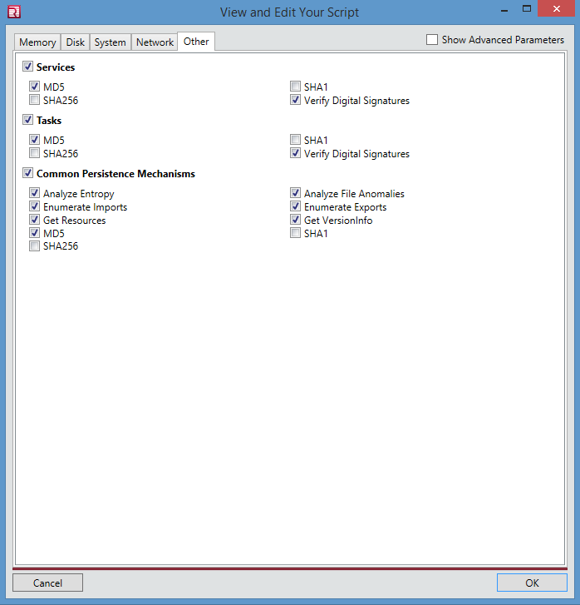
Edit Your Script - Other
This section looks at the services and tasks running on the system.
Also looks for persistence mechanisms for malware
Source: Redline, 2017.
Reproduced and used in accordance with SAIT’s Fair Dealing Policy (Schedule A Copyright and External Materials Procedure AC.2.12.1); further distribution may infringe copyright.

Slide 39
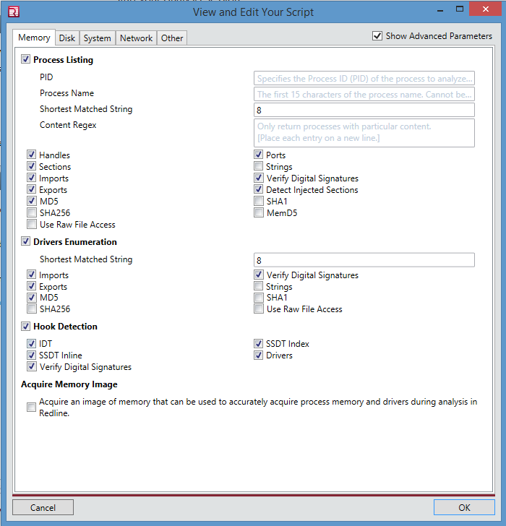
Edit Your Script – Advanced Parameters
Each section allows the user to configure some advanced parameters.
This allows the user to be more granular in what is being collected.
Source: Redline, 2017.
Reproduced and used in accordance with SAIT’s Fair Dealing Policy (Schedule A Copyright and External Materials Procedure AC.2.12.1); further distribution may infringe copyright.

Slide 40
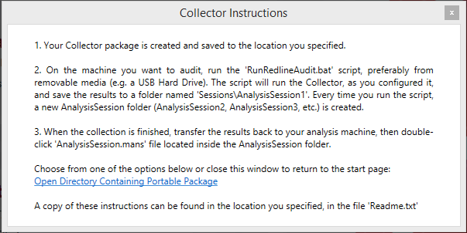
Completed Collection Package
Closing the dialogue box takes you back to the start screen.
Use a portable hard drive to store all of your collections in one place.
Source: Redline, 2017.
Reproduced and used in accordance with SAIT’s Fair Dealing Policy (Schedule A Copyright and External Materials Procedure AC.2.12.1); further distribution may infringe copyright.

Slide 41
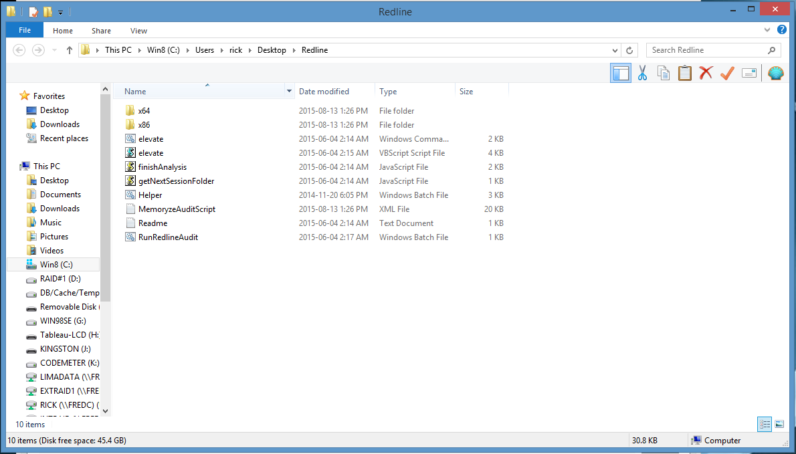
Contents of the Folder
Run the File “RunRedlineAudit” from an Administrator Command Prompt.
Will work with 32 and 64 bit operating systems
Used with permission from Microsoft.

Slide 42
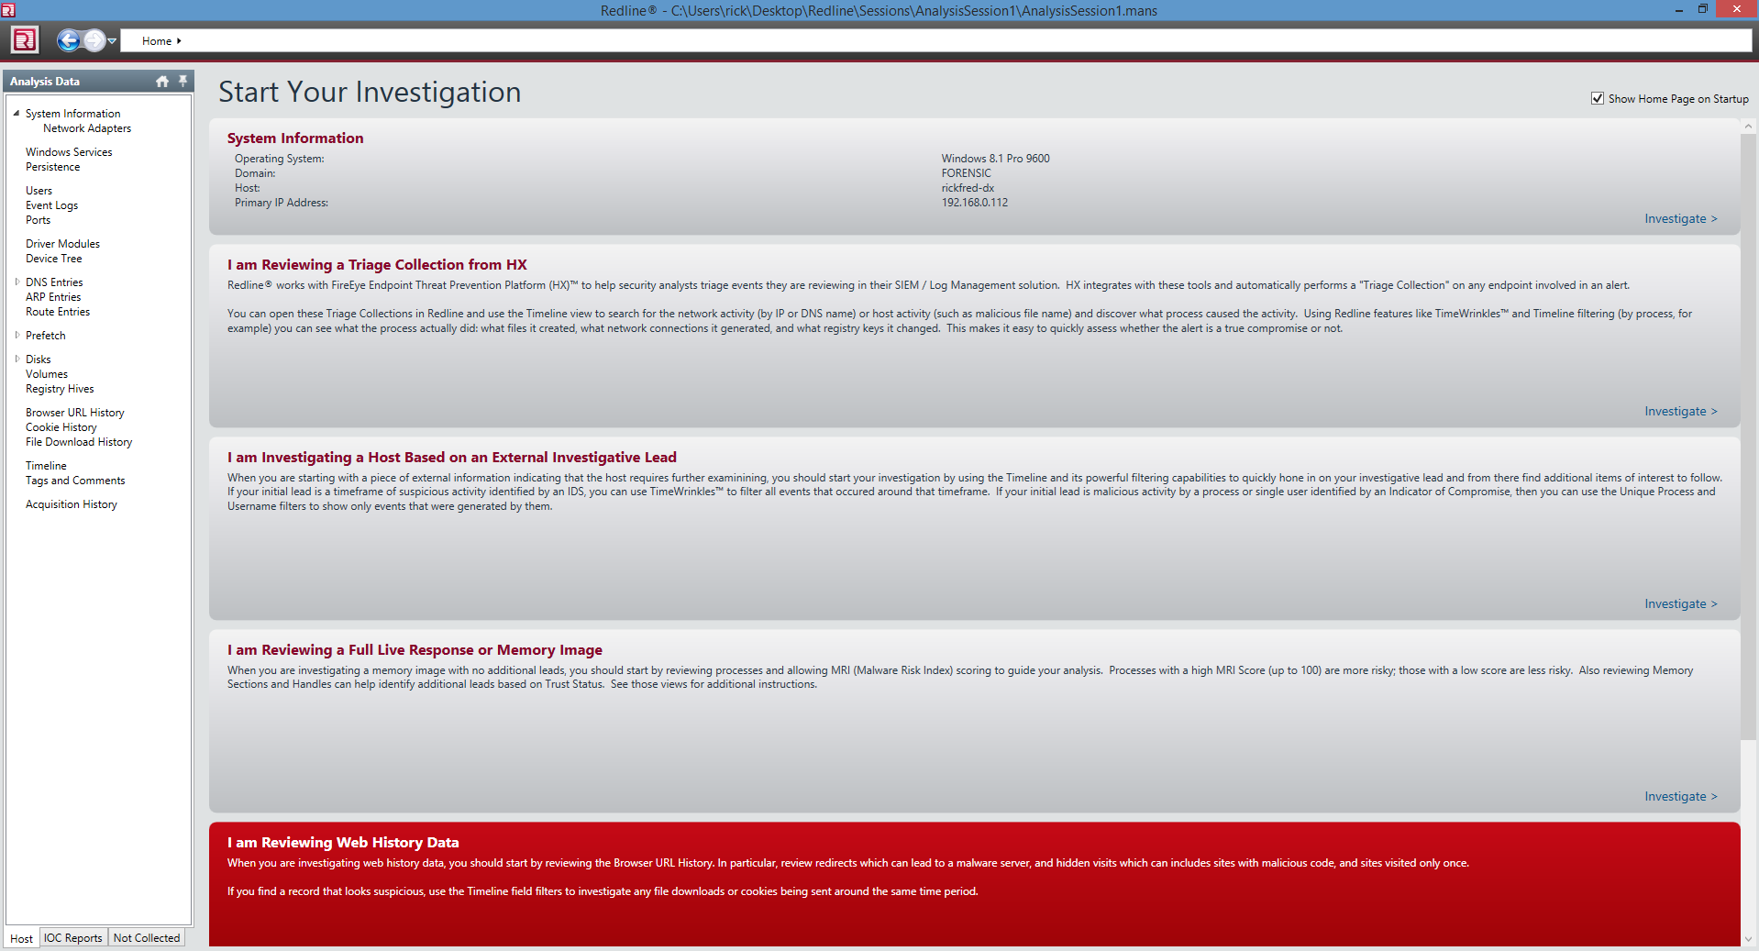
Redline Analysis Home Page
Source: Redline, 2017.
Reproduced and used in accordance with SAIT’s Fair Dealing Policy (Schedule A Copyright and External Materials Procedure AC.2.12.1); further distribution may infringe copyright.

Slide 43
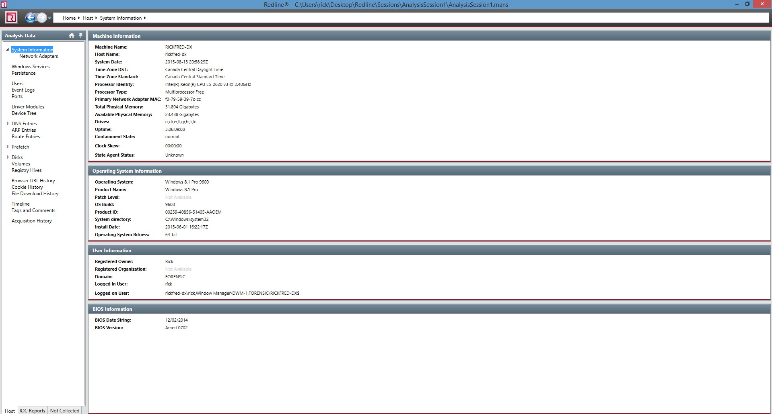
Redline - Analysis
Source: Redline, 2017. Reproduced and used in accordance with SAIT’s Fair Dealing Policy (Schedule A Copyright and External Materials Procedure AC.2.12.1); further distribution may infringe copyright.

Slide 44
Summary
A live response is often a critical part of the incident response process
Used to gather volatile data which will be lost once the system is shut down
Goal is to gather the evidence while creating as few changes as possible to the system in the process
Use commercial, open source toolkits or create your own toolkit
Script the process to minimize interaction with the system and ensure consistency of the tools run during live response

Slide 45
References
FireEye. (2012). IOC Editor (Version 2.2) [Computer software]. Retrieved from https://www.fireeye.com/services/freeware/ioc-editor.html.
FireEye Incident Response. (n.d.). Retrieved Sep. 26, 2017 from http://forensicswiki.org/wiki/ Incident_Response
IOC Bucket. (2013). Retrieved from https://www.iocbucket.com/iocs/9cec8b496b4111051bc71c6d1fe1bf5cbcdc3f27

Slide 46
References
Luttgens, J. T., Pepe, M. and Mandia, K. (2014). Incident response & computer forensics (3rd ed.). Toronto: McGraw Hill.

Slide 47
© 2017, Southern Alberta Institute of Technology. All rights reserved.
This publication and materials herein are protected by applicable intellectual property laws. Unauthorized reproduction and distribution of this publication in whole or part is prohibited.
For more information, contact:
Director, Centre for Instructional Technology and Development
Southern Alberta Institute of Technology
1301 16 Ave. N.W., Calgary, AB T2M 0L4

